Slide 1
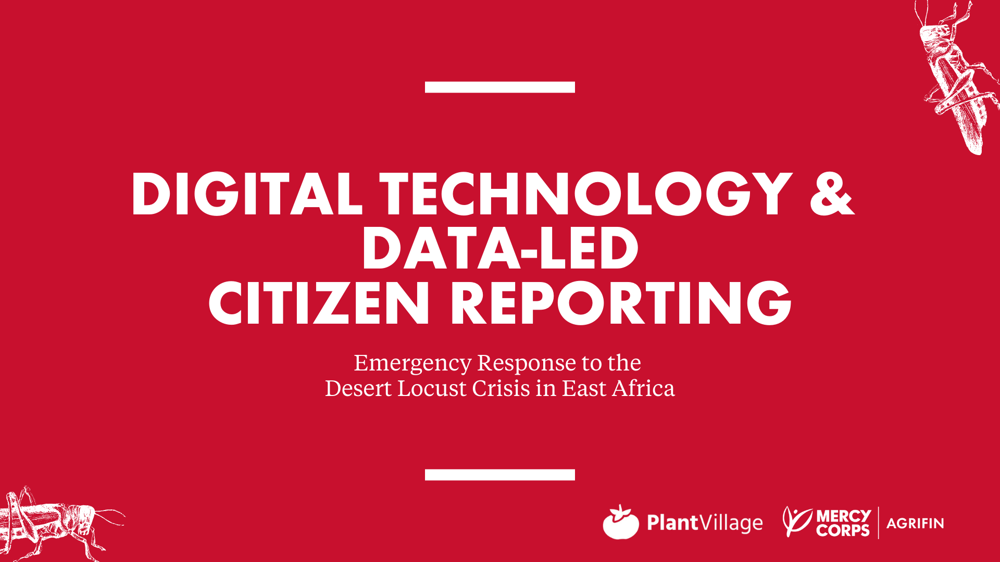

Slide 2

Agenda
Presentation 1 - PlantVillage
Presentation 2 - AgriFin
Panel
Audience Q&A

Slide 3

Program Director AgriFin
Associate Professor
Plant Village, Penn State
Emergency Response Manager
AgriFin

Slide 4

Mercy Corps’ AgriFin programming (MCAF) represents USD 35 million in innovation funding from the Mastercard Foundation, Bill and Melinda Gates Foundation and the Swiss Development Corporation to support development, testing and scale of digitally-enabled services for smallholder farmers.
Our objective is to develop sustainable services that increase farmer income and productivity by 50%, with 50% outreach to women
MCAF works as an innovation partner with private sector scale partners and such as banks, mobile network operators, agribusinesses, as well as technology innovators and governments committed to serving smallholders at scale
We help our partners develop, test and scale bundles of digitally-enabled financial and non-financial services supporting partnership development between market actors that leverage their strengths
We combine MCAF team expertise with strategic subsidy to jointly implement iterative, fail-fast engagements with partners on a cost-share basis, sharing public learnings to drive market ecosystem growth
Since 2015, we have completed more than 200 engagements with over 120 partners across Africa
With the onset of the Desert Locust in East Africa, the Skoll Foundation funded AgriFin’s first emergency response work leveraging digital tools
With this support, AgriFin now reaches more than 8 million smallholders

Slide 5
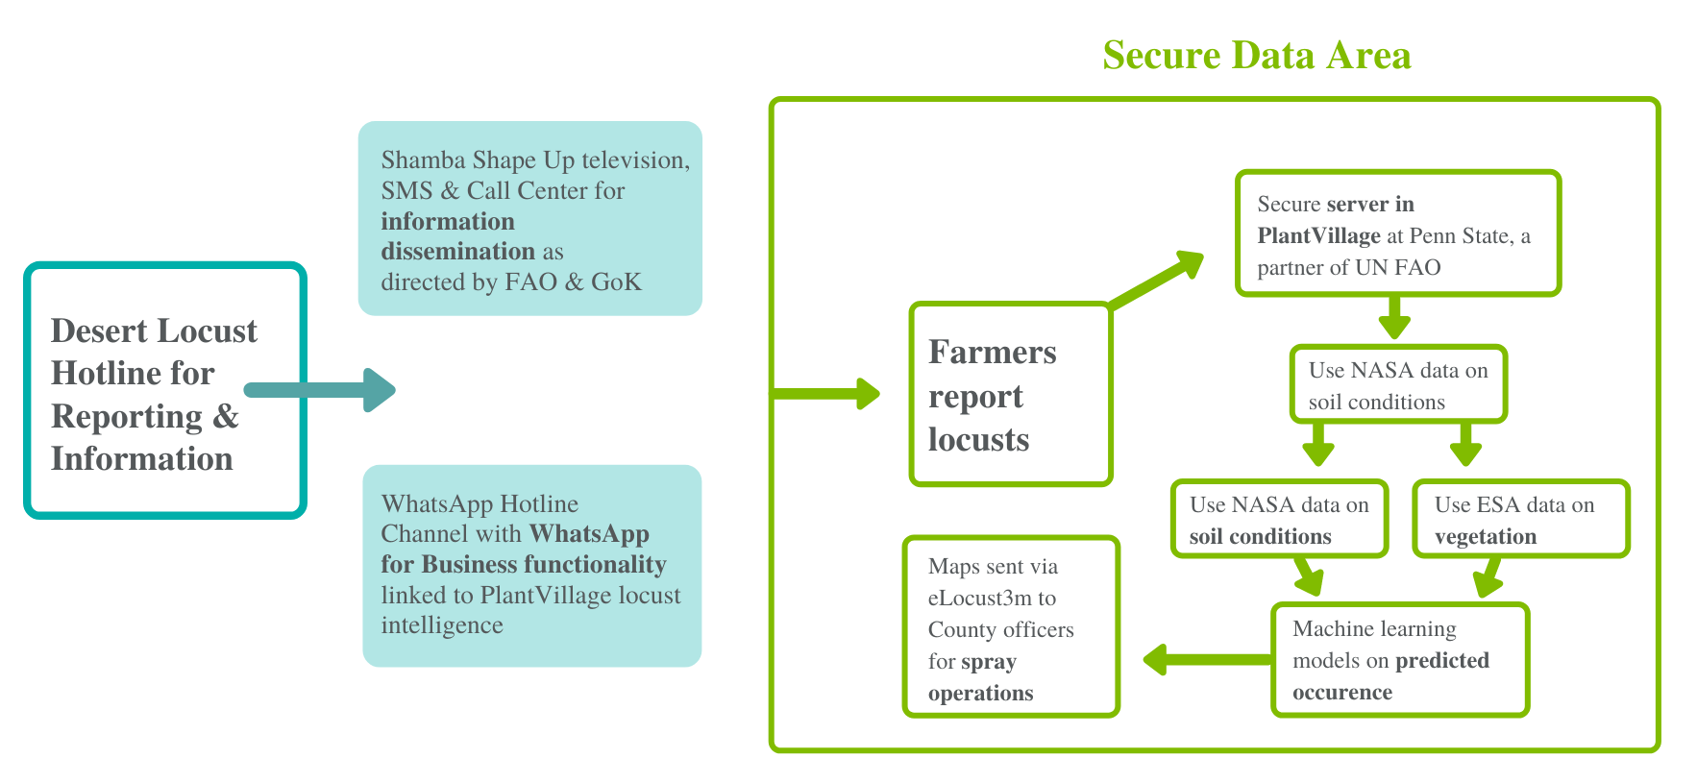
PROCESS & DATA FLOW FOR KENYA DESERT LOCUST REPORTING & INFORMATION HOTLINE - Government and FAO buy-in were key

Slide 6

PlantVillage:
Empowering the crowd to track the Desert Locust
David Hughes
Associate Professor of Entomology and Biology, Penn State University
dhughes@psu.edu

Slide 7
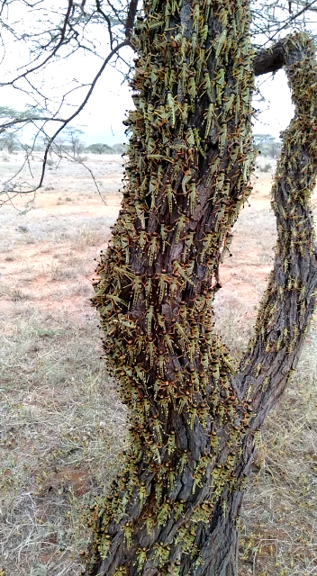
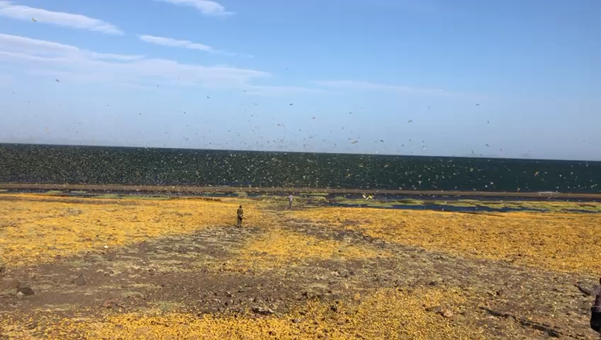
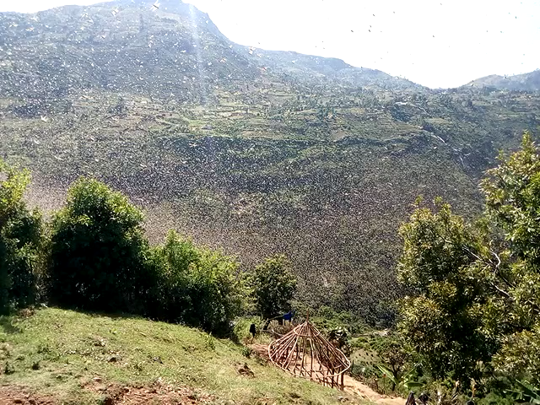
The Locust Crisis in East Africa: 2020

Slide 8
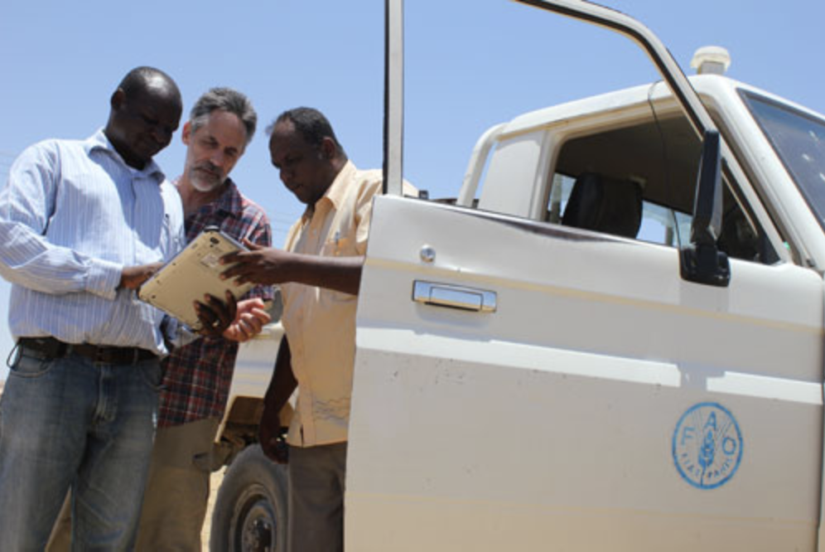
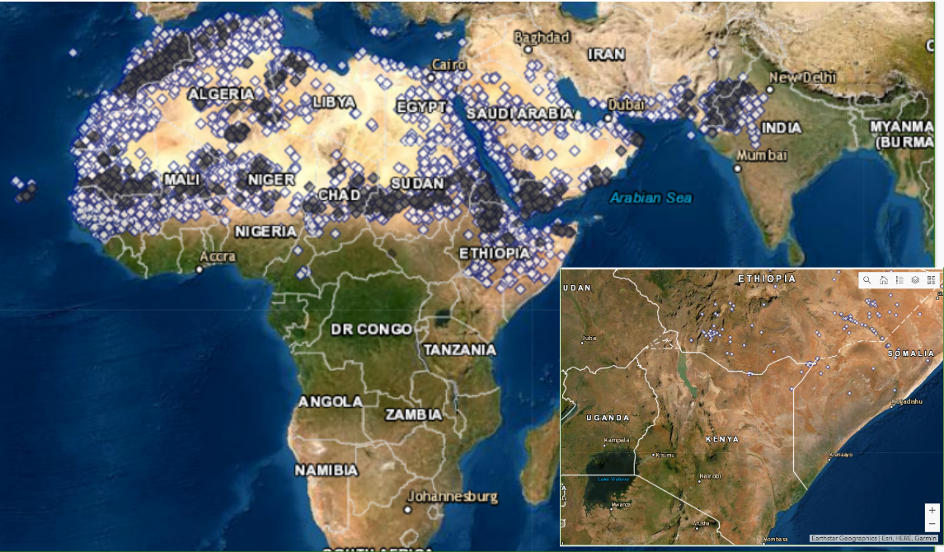
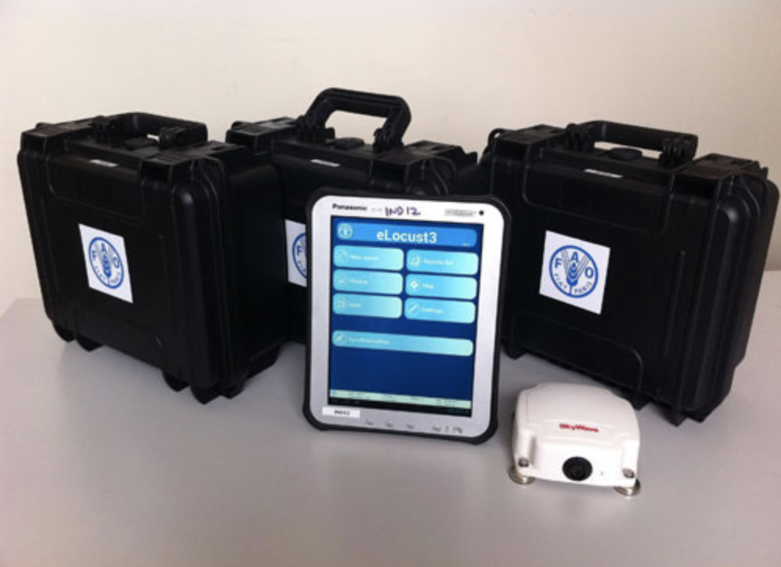
Locust Tracking: traditionally done by experts at UN FAO with field teams
Dec 28th 2019
26,000 records collected between 1985-2019 by dedicated field officers with UN FAO

Slide 9
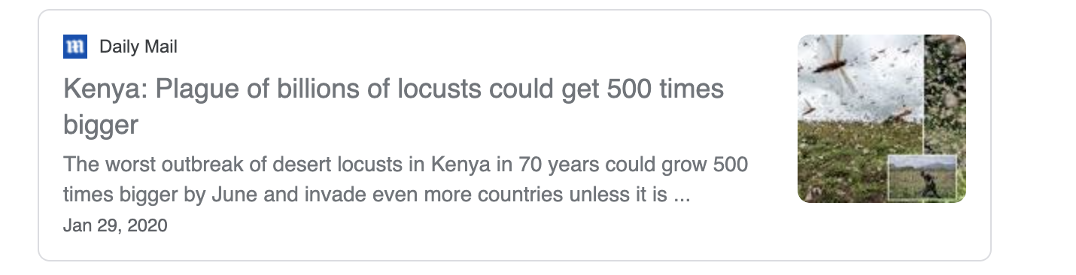
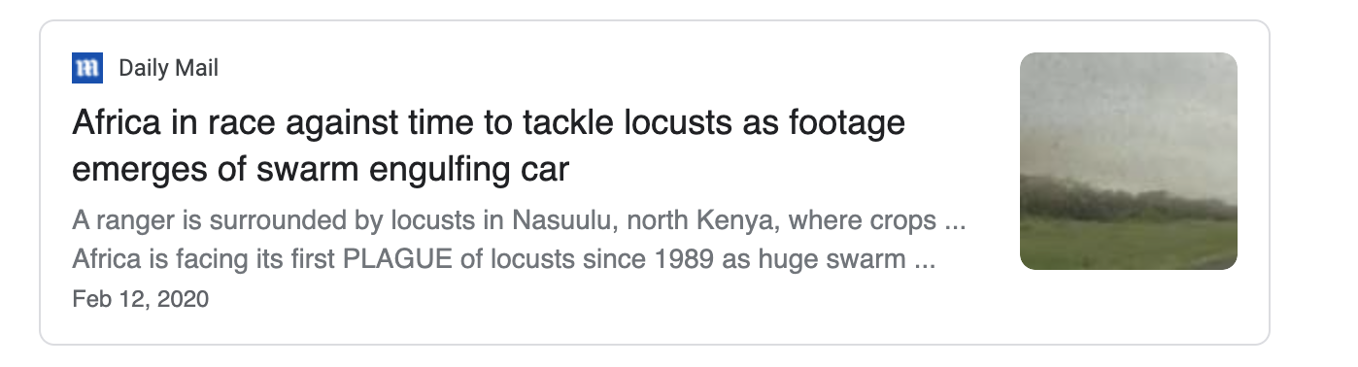
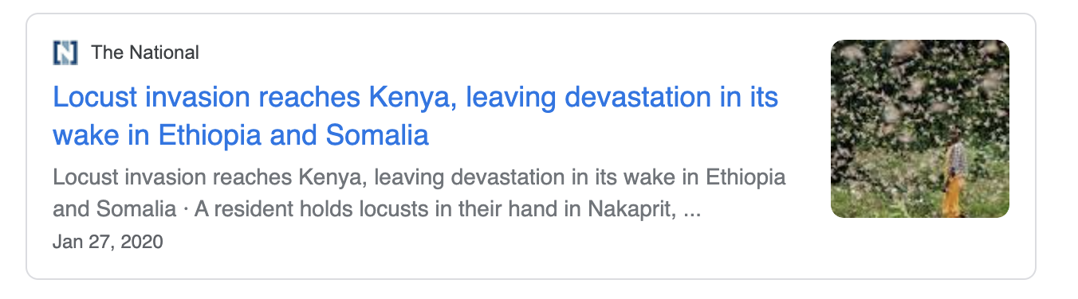
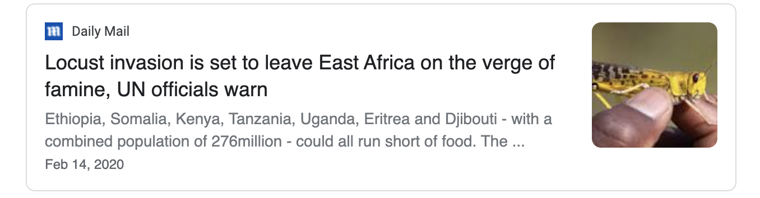
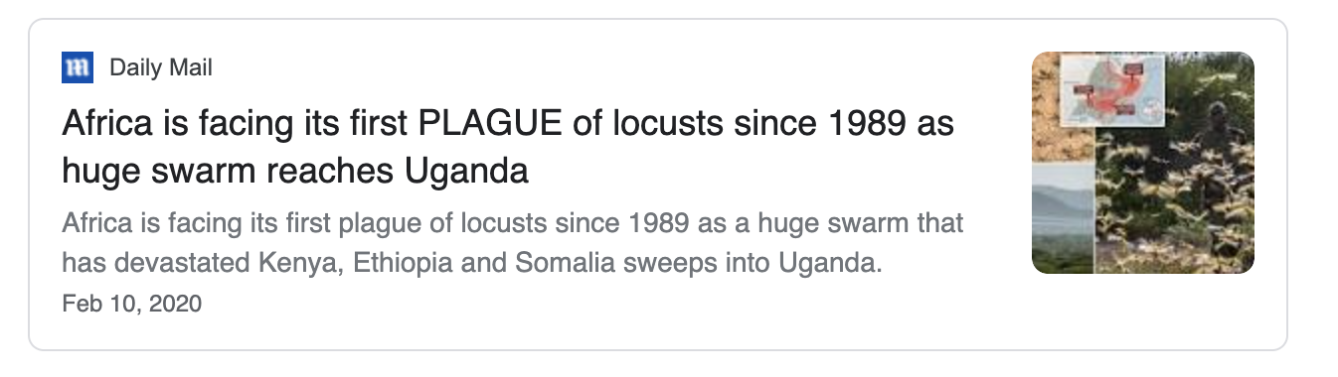
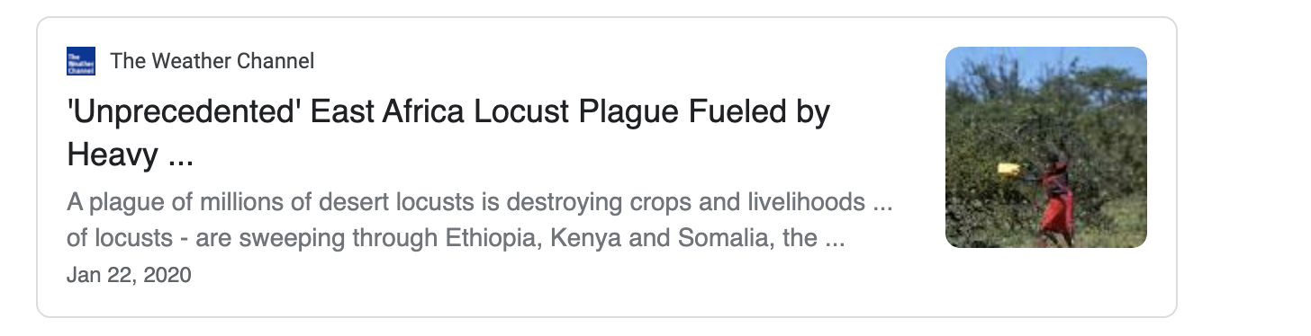
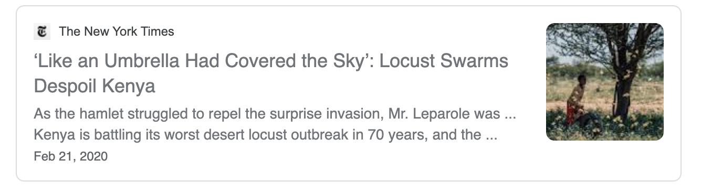
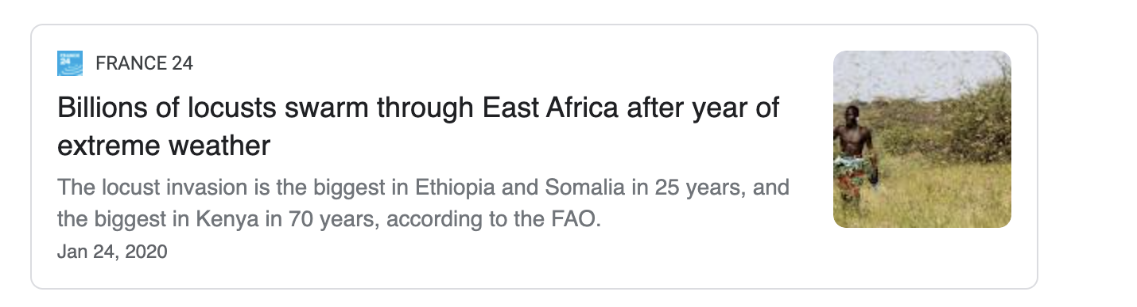
Kenya: a country unprepared for Locusts
March 11th COVID19 Pandemic declared by WHO: shut down travel between counties in Kenya

Slide 10
PlantVillage, as a UN FAO Partner, was asked to provide an emergency response
1) Build a Desert Locust surveillance tool for non-experts
2) Deploy Locust Crisis teams

Slide 11
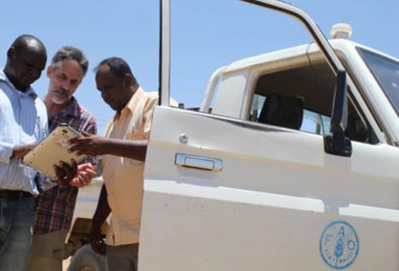
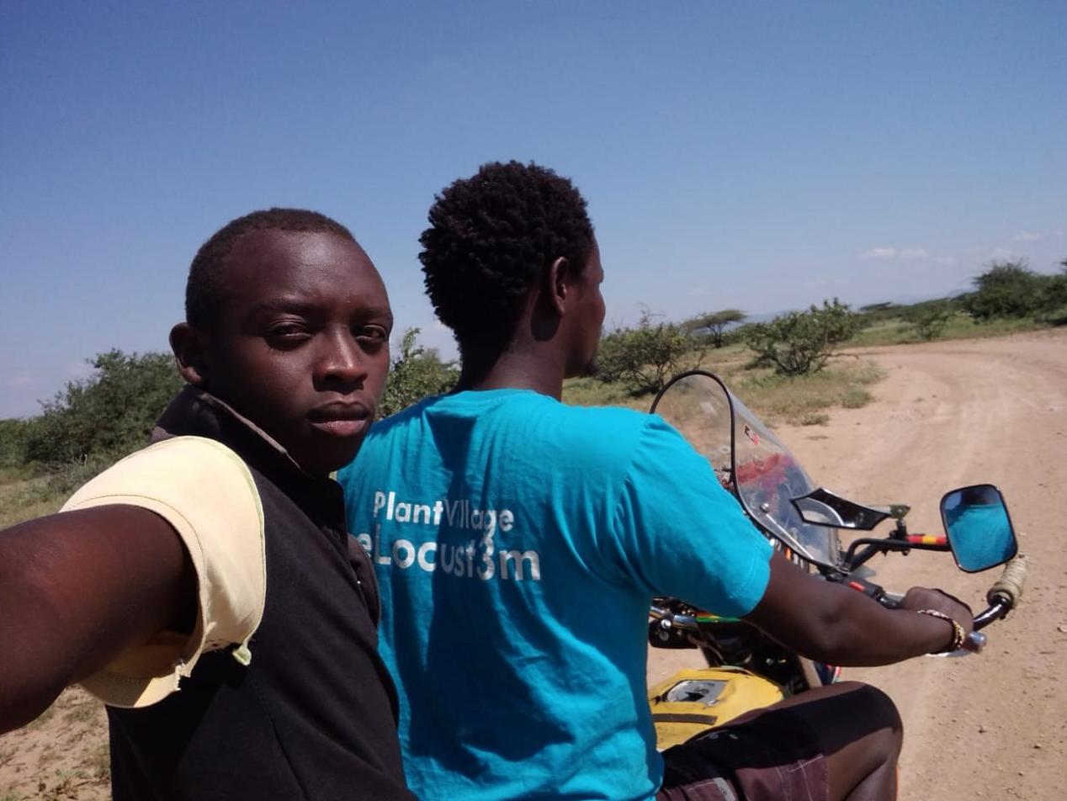
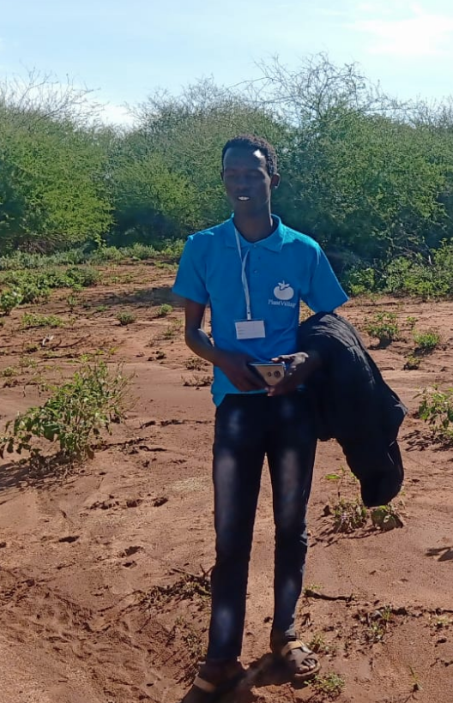
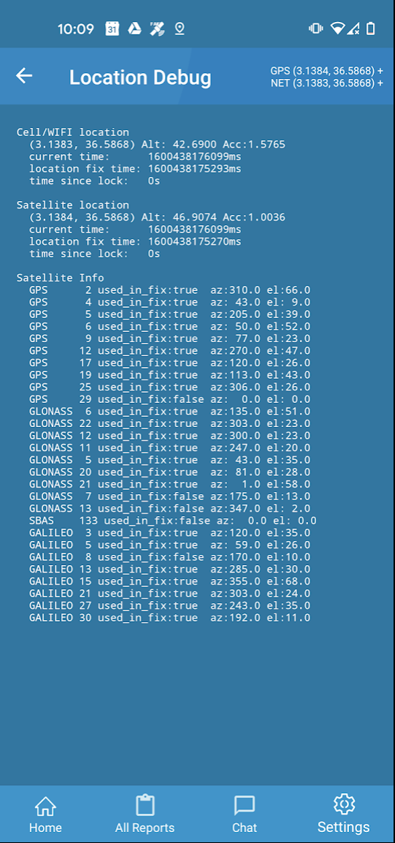
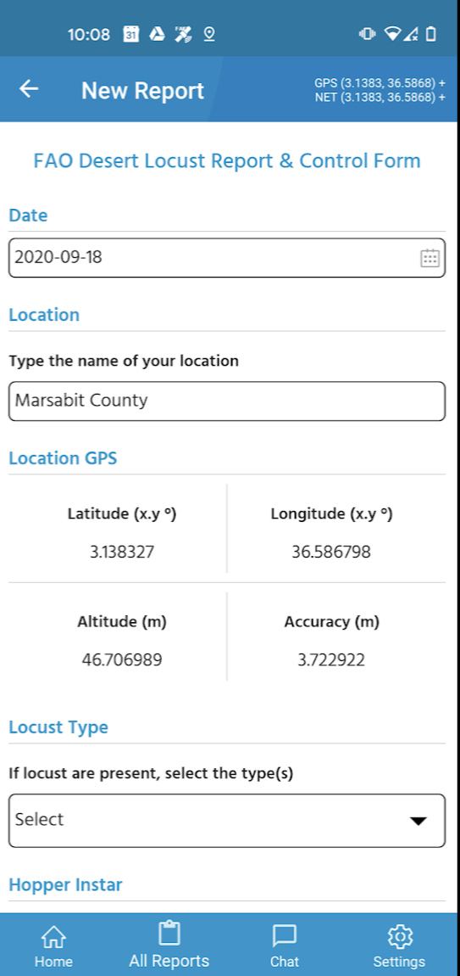

1: Surveillance: eLocust3m- a satellite connected app for anyone to collect data like an FAO expert
vs
Frank Doyle at PlantVillage

Slide 12
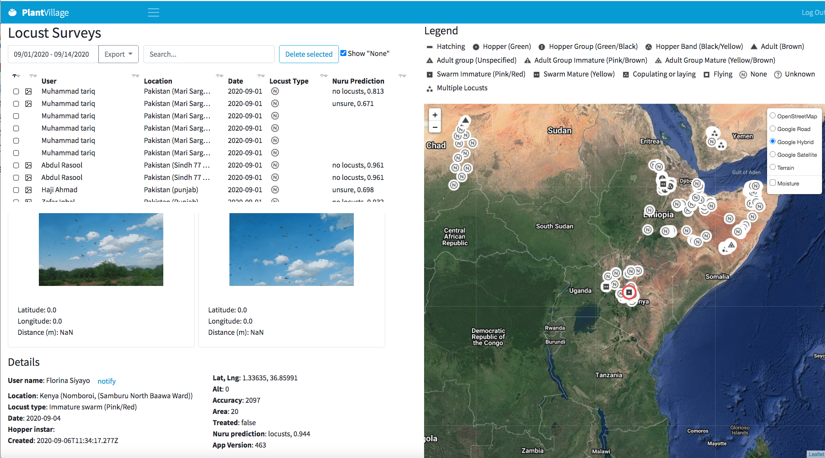
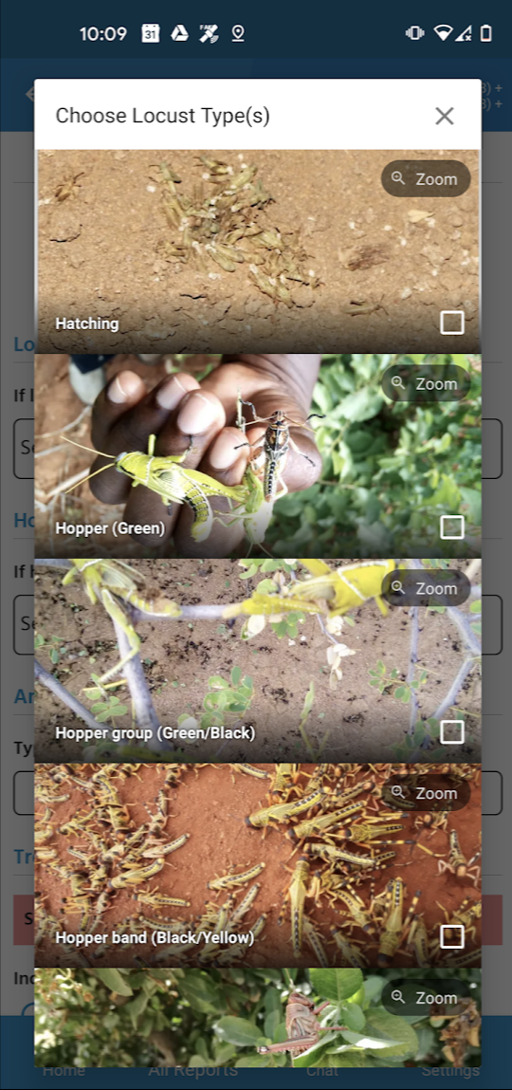
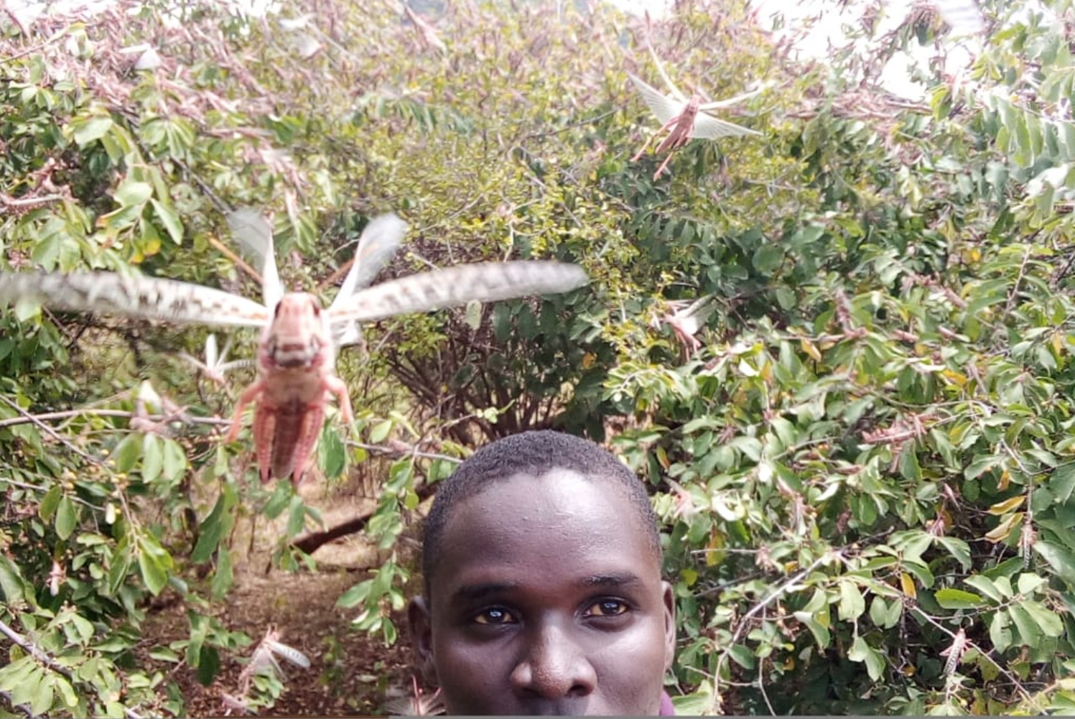


1: Surveillance: eLocust3m- AI assisted classification
vs
Keith Cressman, Senior Locust Forecaster at UN FAO
Tyson Yassin, PlantVillage team member
>100,000 images collected
Pete McCloskey and Rohit Gangupantulu- AI engineers at PlantVillage + 45 current undergrads

Slide 13
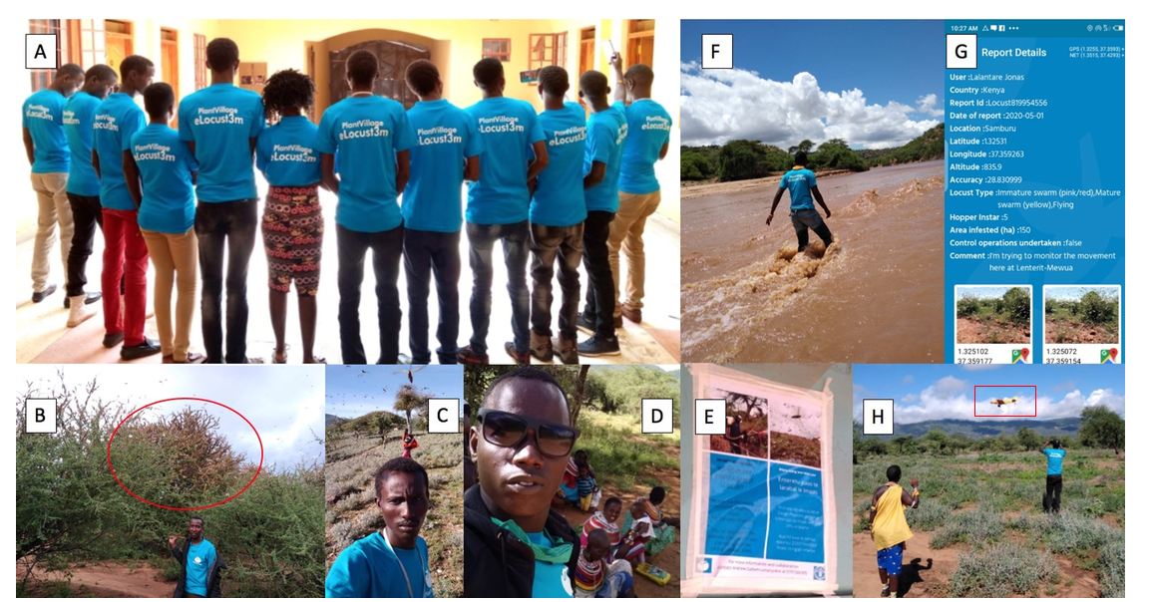
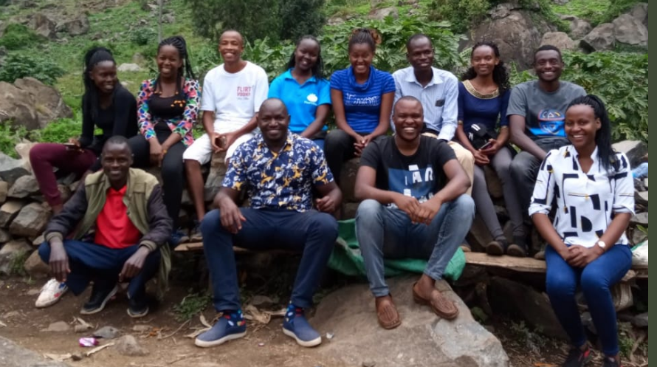
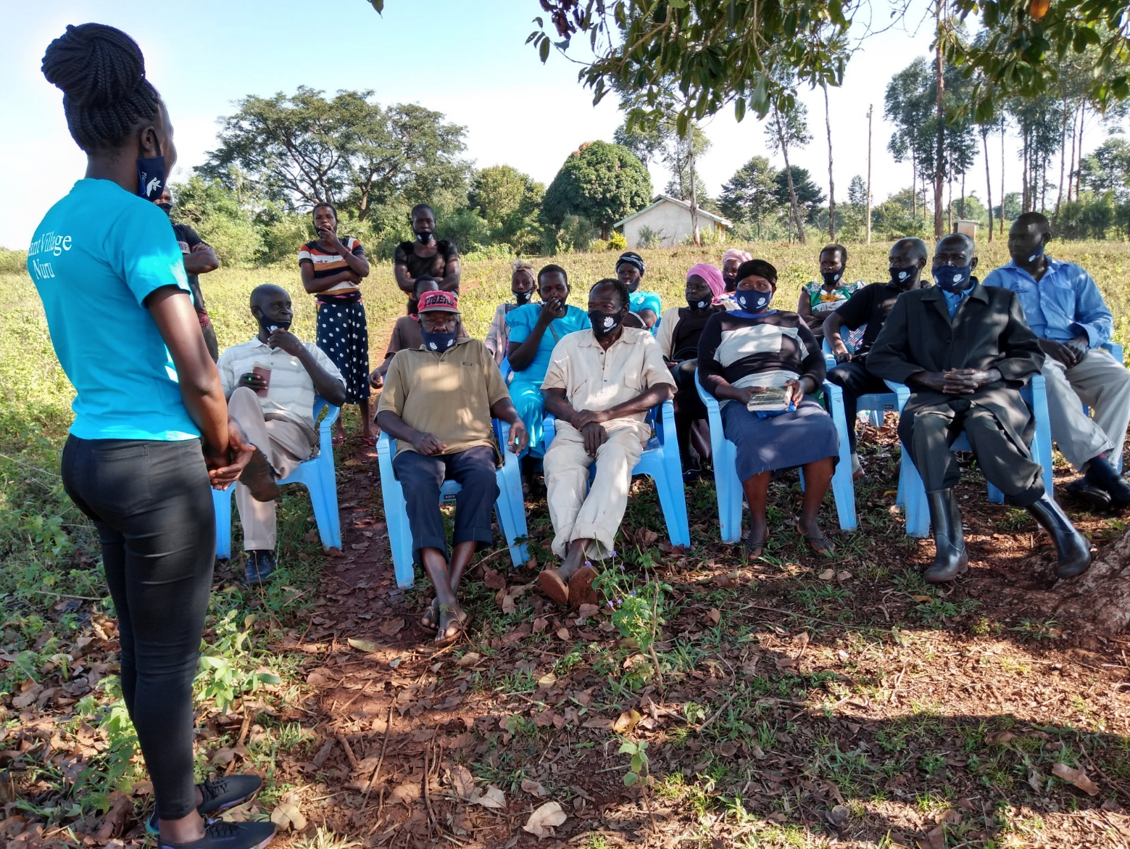

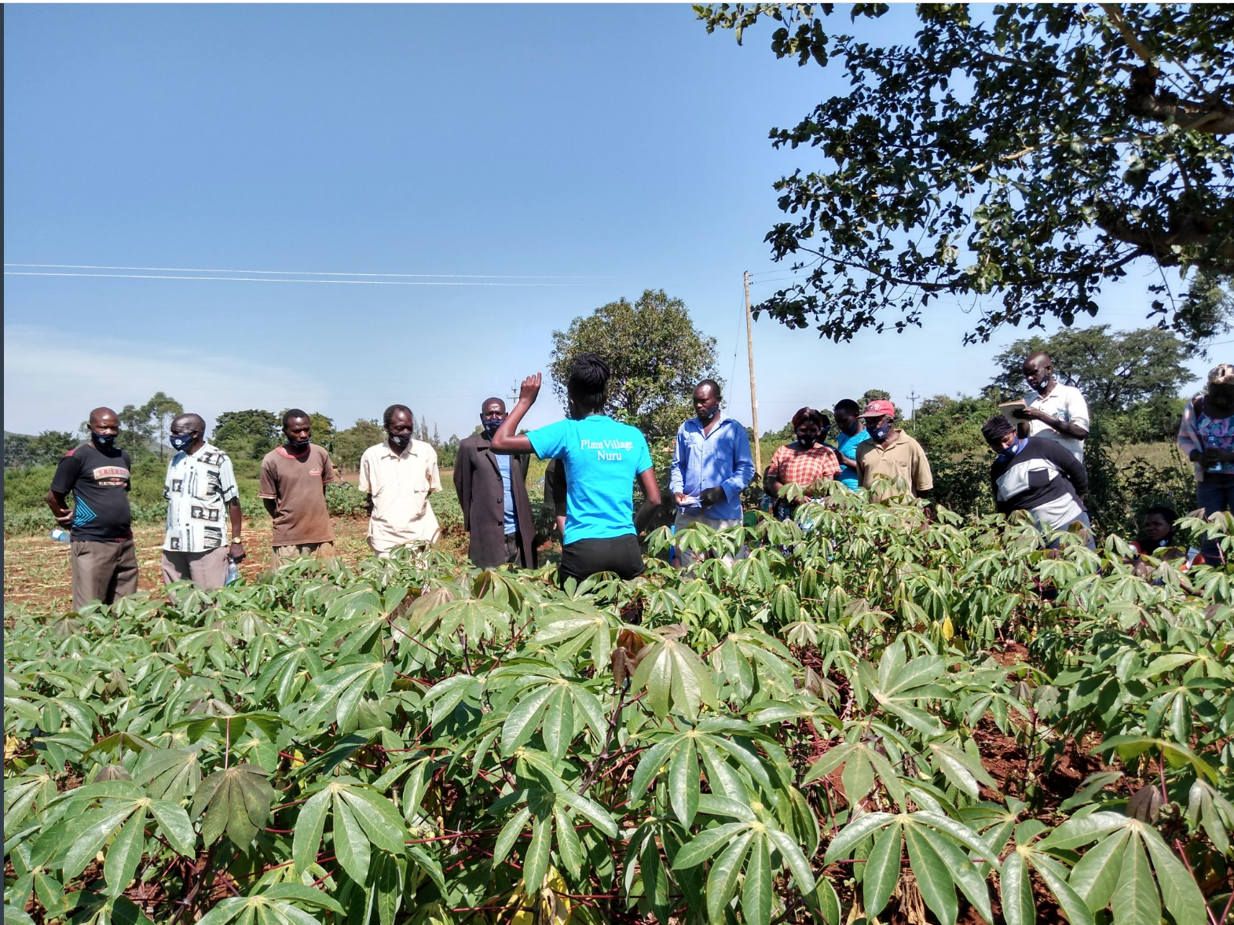
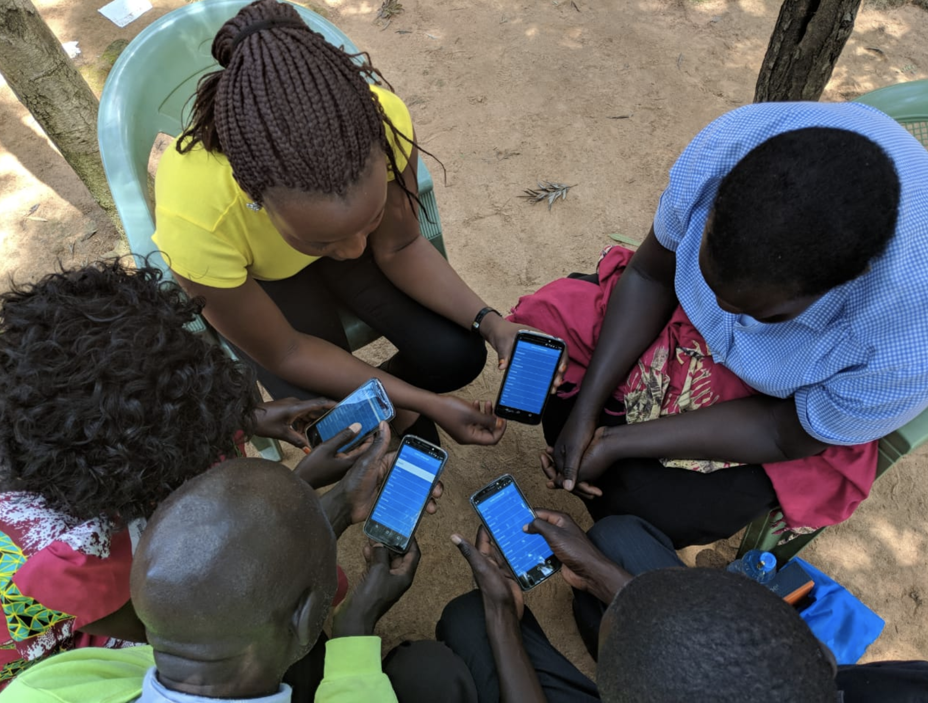
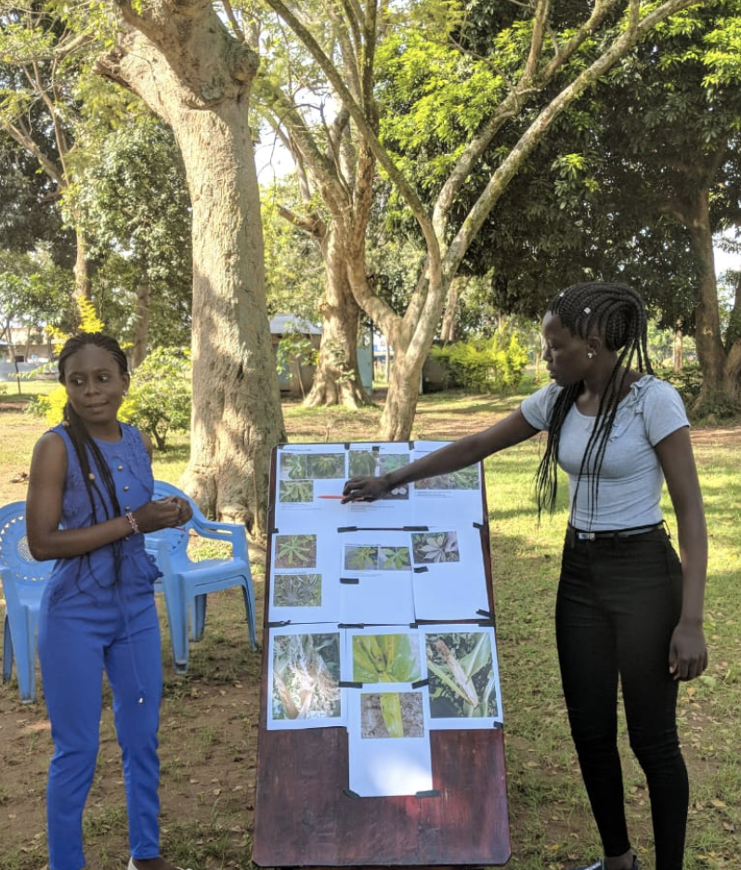
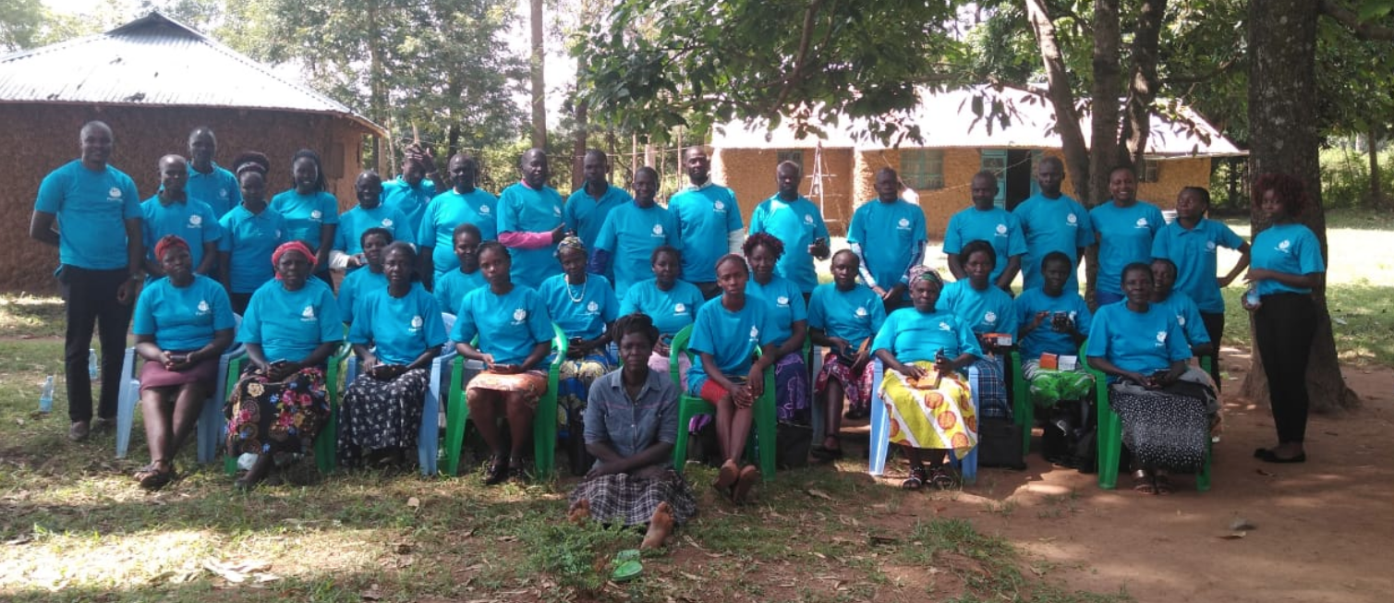
2) Deploy Locust Crisis teams (modelled on PV Dream Teams)

Slide 14
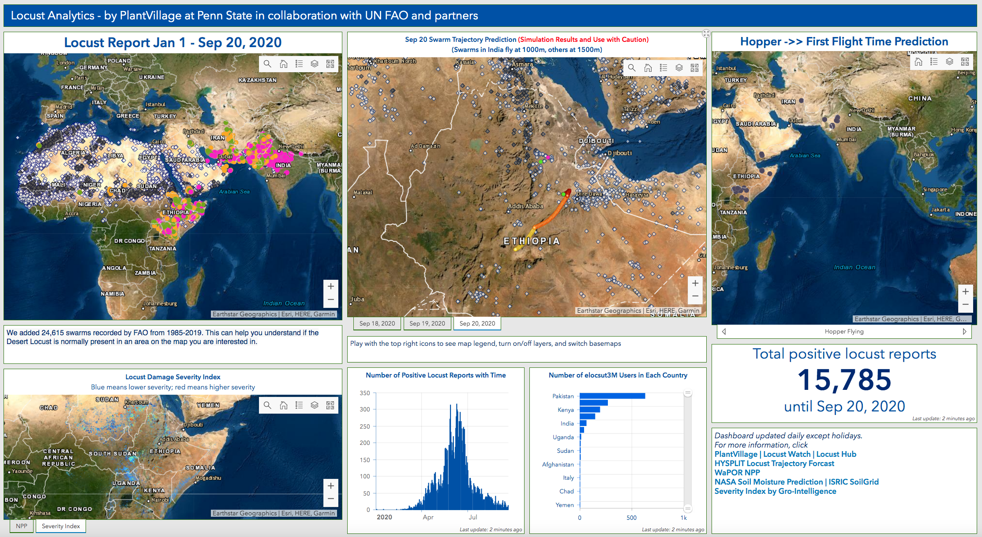
ArcGIS platform integrated with NASA, NOAA, ISRIC, Gro-Intellgence etc
arcg.is/0aHGHi

Slide 15
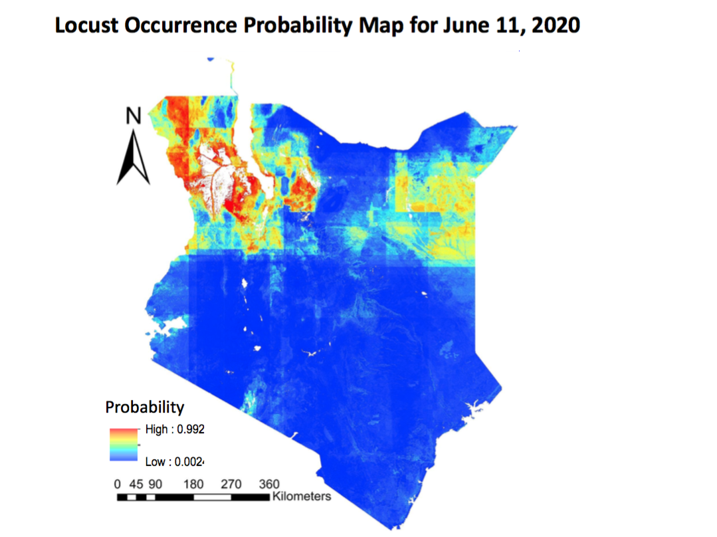
Machine learning to predict occurrence
ISRIC Soil Types
Weather
NASA satellite Soil Moisture
Historical records
Lat, Long
Crop growth
Fei Jiang & Derek Morr

Slide 16
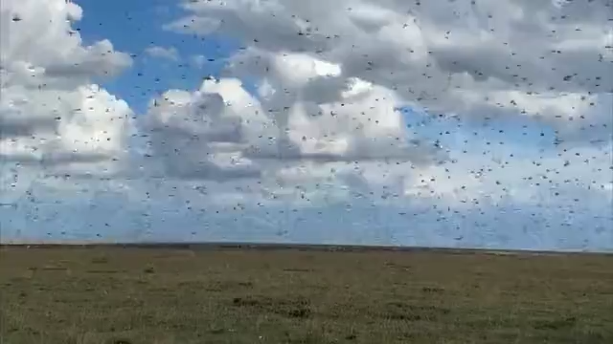
Advice to 6 million farmers/week via Shamba Shape Up & Mercy Corps

Slide 17
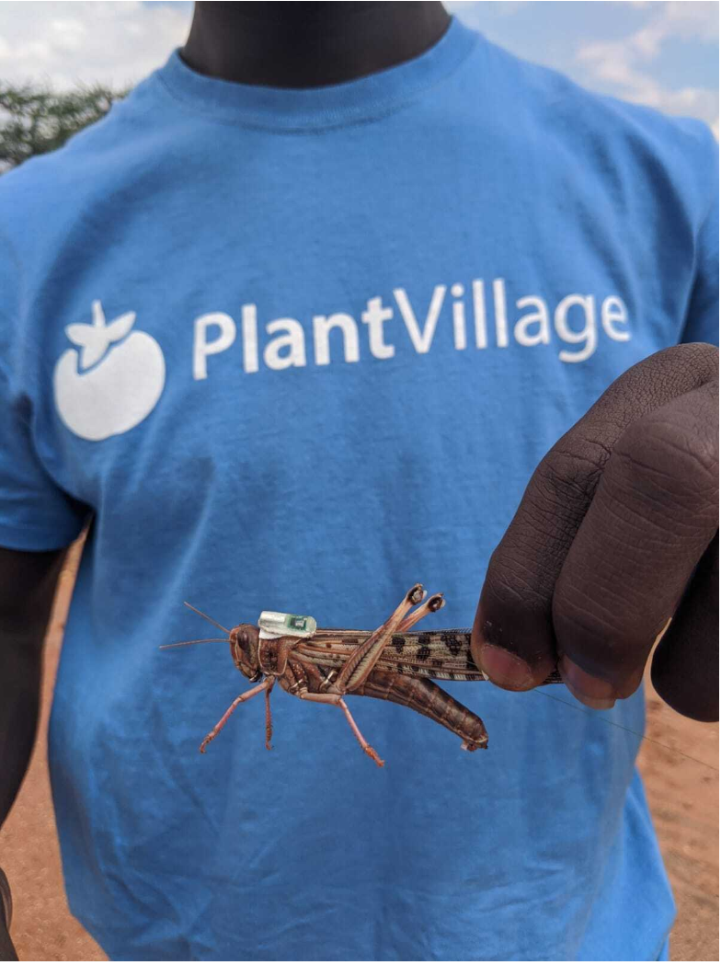
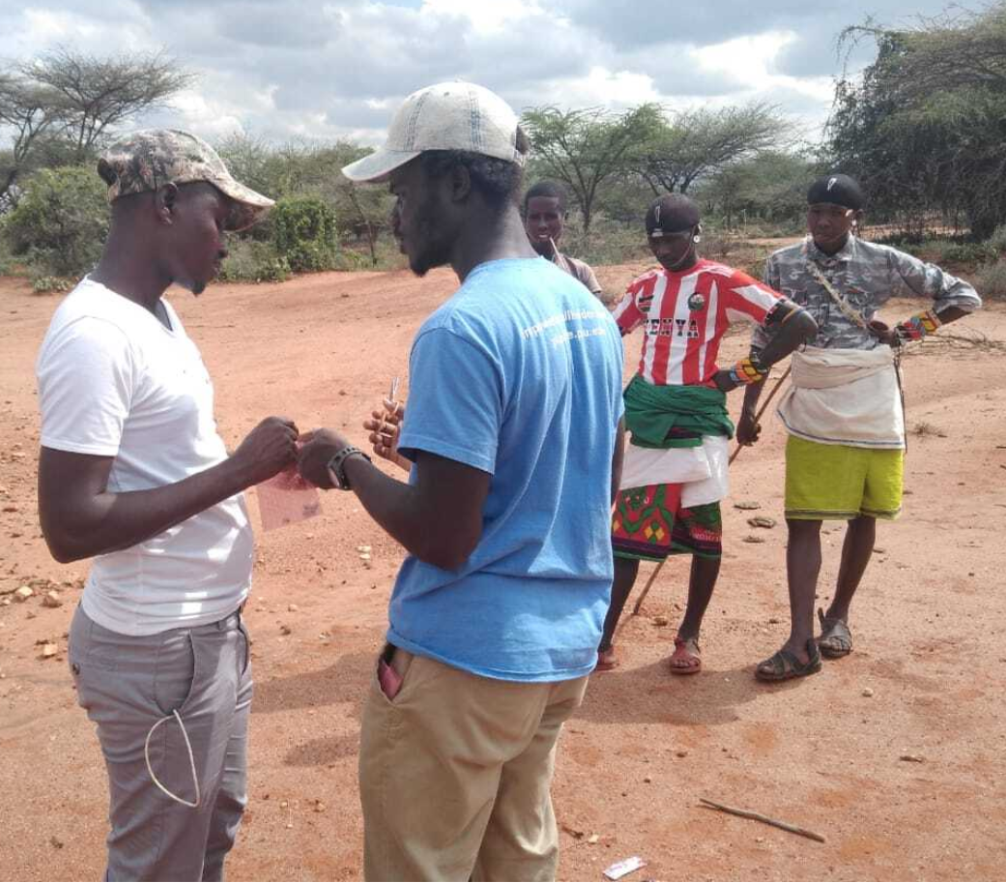
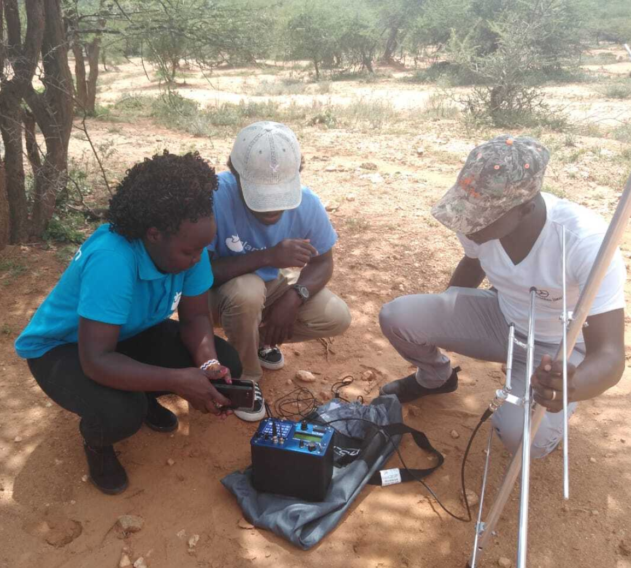
More and better technology!
Edward Amoah, Melodine Jeptoo and John Chelal

Slide 18
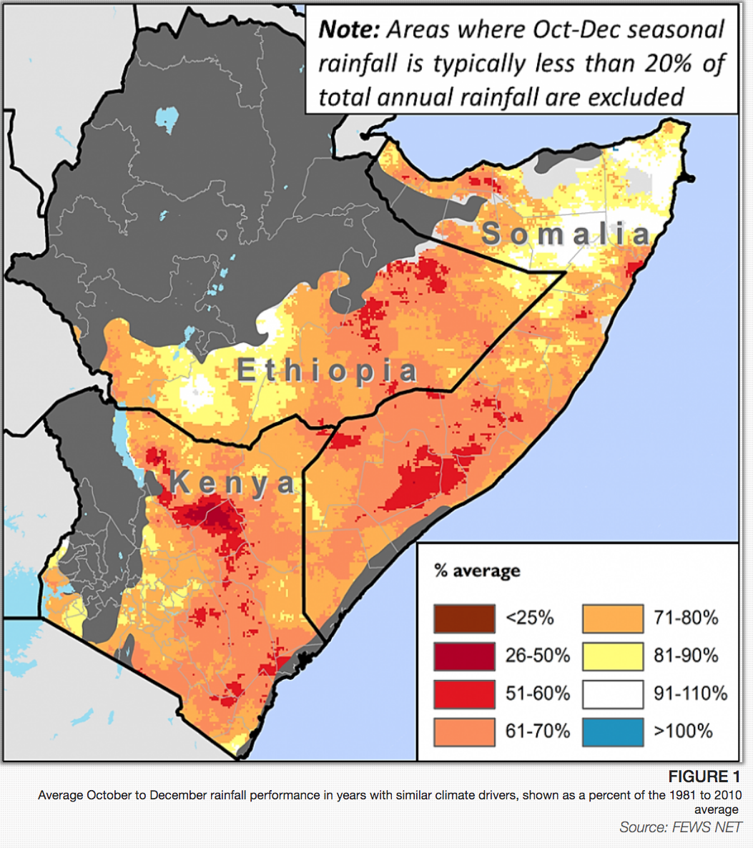
Conclusion
Technology brings the crowd to a level comparable with professionals
The crowd is bigger, cheaper and in more places
Many ways to use the crowd (TV/SMS/WhatsApp)
  Next talk by John Mundy of Mercy Corps
Bigger problems lie ahead (2020 is not done!)

Slide 19
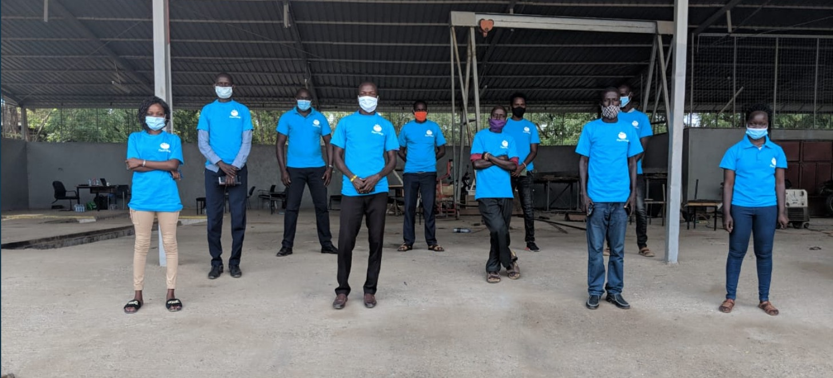
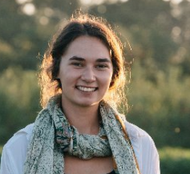
Acknowledgments
Melodine Jeptoo
Dr John Chelal
Annalyse Kehs
Locust Team members (62)
PlantVillage Deam Team (12)
Hoodies Team
Mercy Corps
Mediae Company
Turn.Io
FAO
WFP
Government of Kenya
Government of Ethiopia
Funders
Skoll Foundation
Schmidt Futures
Bill and Melinda Gates Foundation/FAO

Slide 20

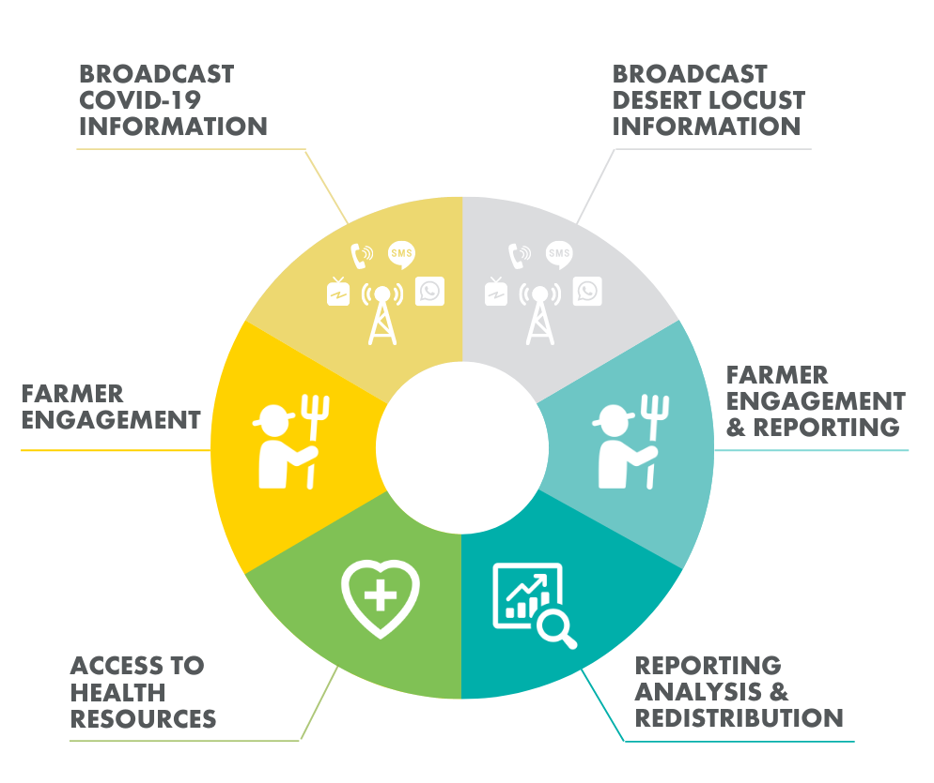
using a data-led public information campaign and citizen reporting model to
address desert locusts & covid-19

Slide 21

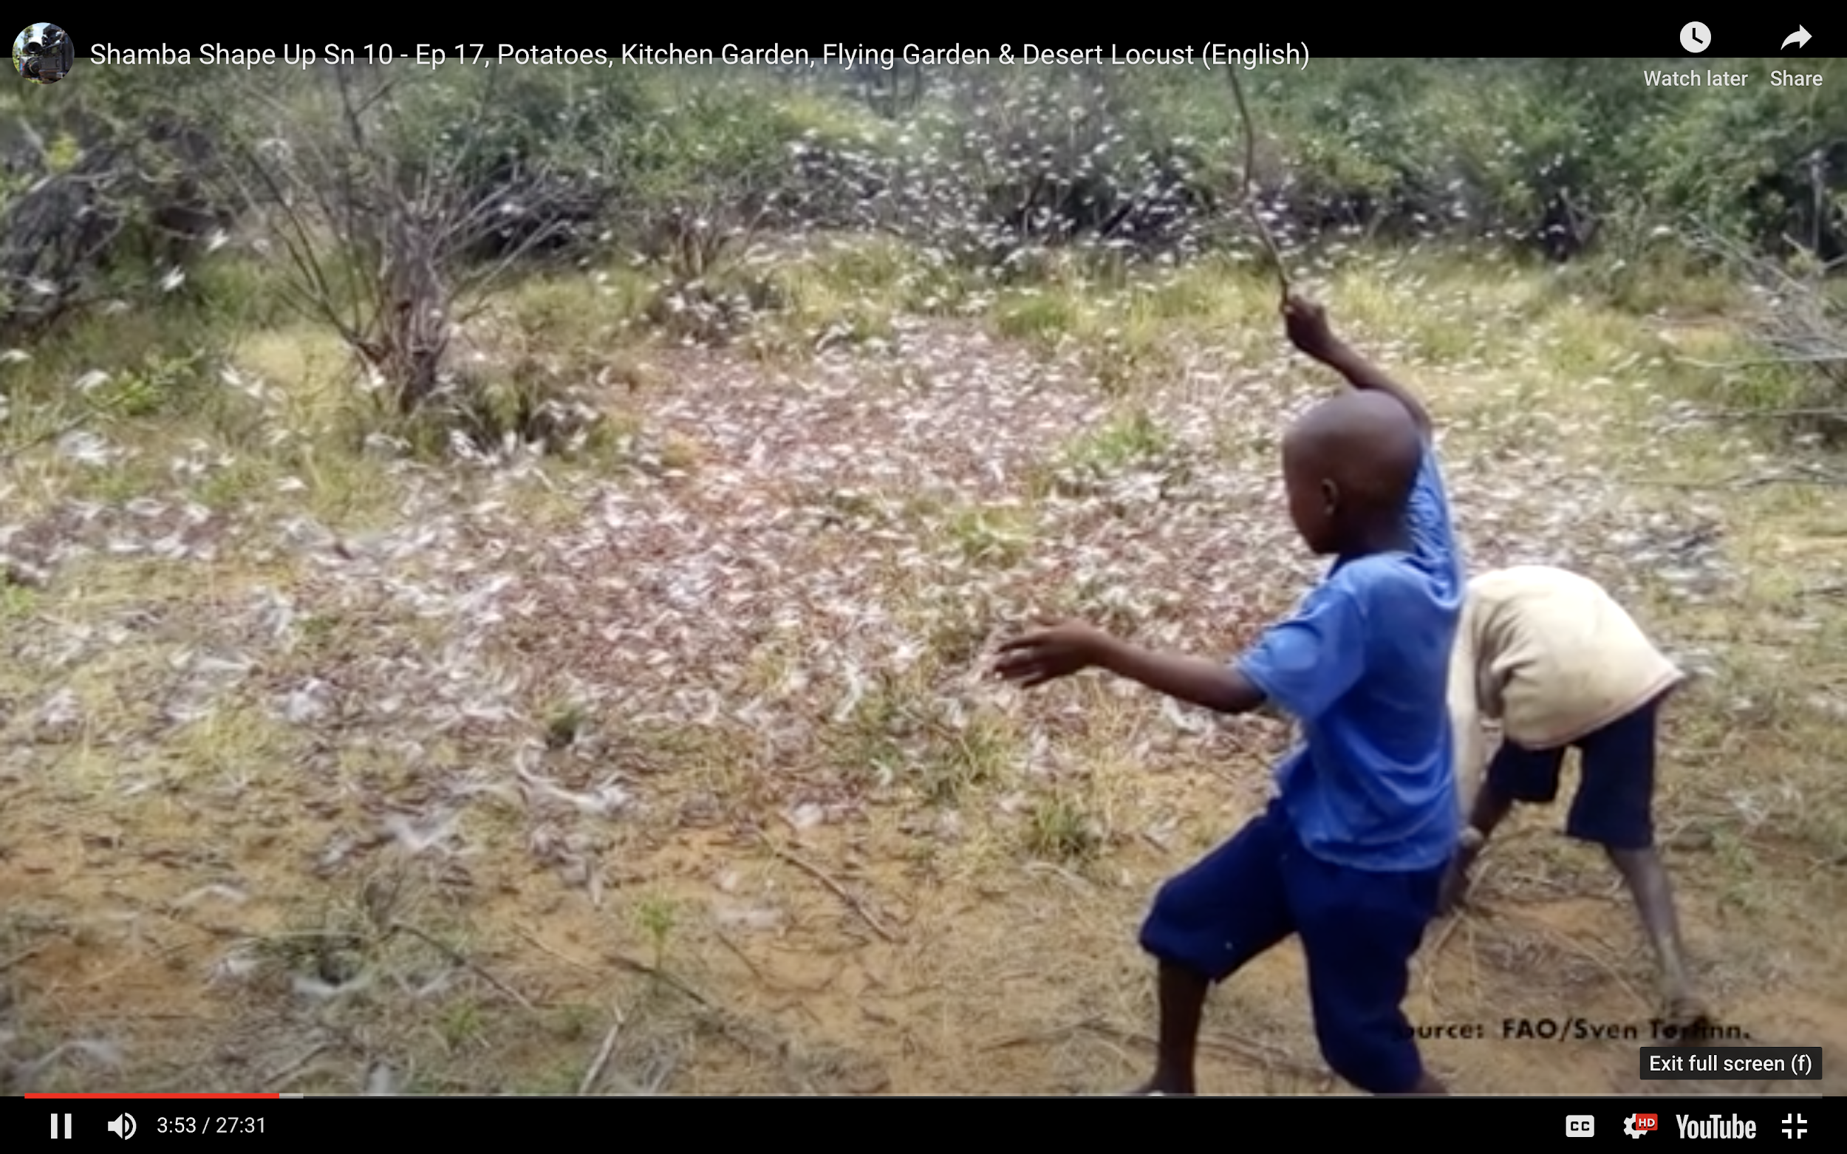
Mediae’s Shamba Shape Up Program is reaching 6 million farmers in Kenya every weekend
Public Information Campaign - T.V. and Radio
Call to Action
Farmer feedback loop - maps and forecasting
Emergency response requires all media messaging and digital reporting channels acting in unison
Mediae’s TV programming has the call to action with iShamba hosting whatsapp, sms, call center and data aggregation needs for reportings

Slide 22
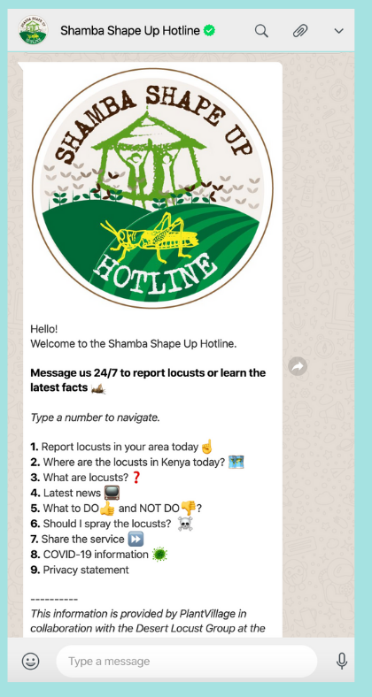
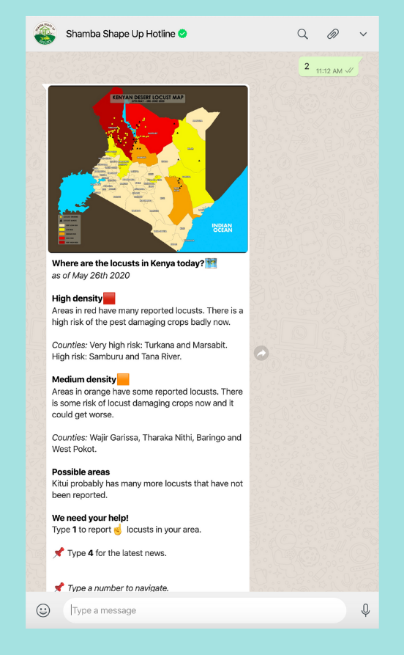
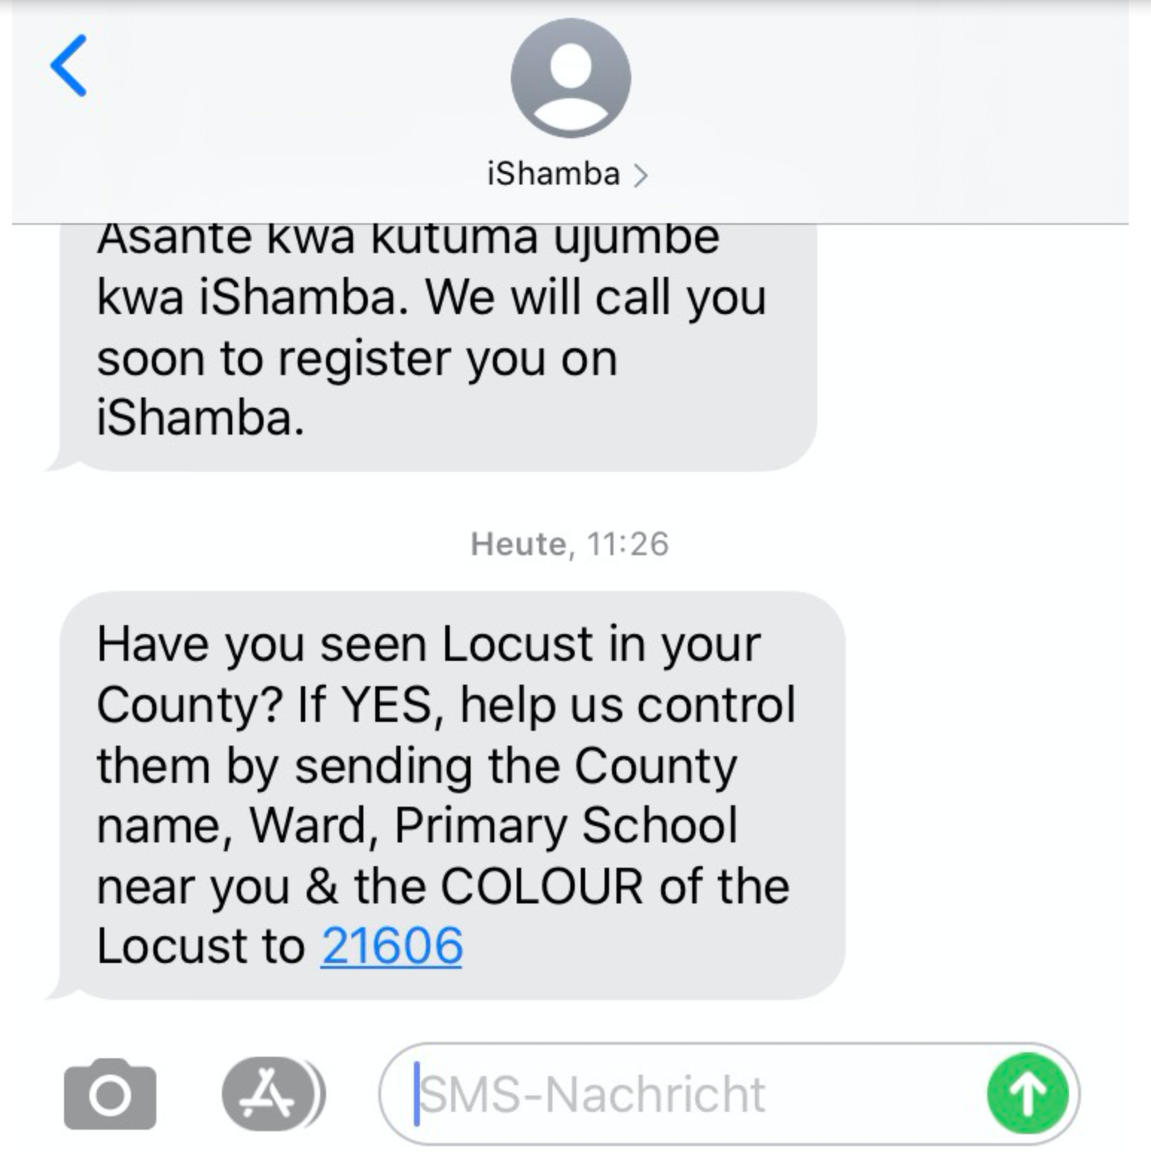
Kenya WhatsApp: SHAMBA SHAPE UP HOTLINE
Kenya SMS: Text ‘LOCUST’ to 21606
Note: Call center team and data aggregation by iShamba ensures validity and quality control.

Slide 23
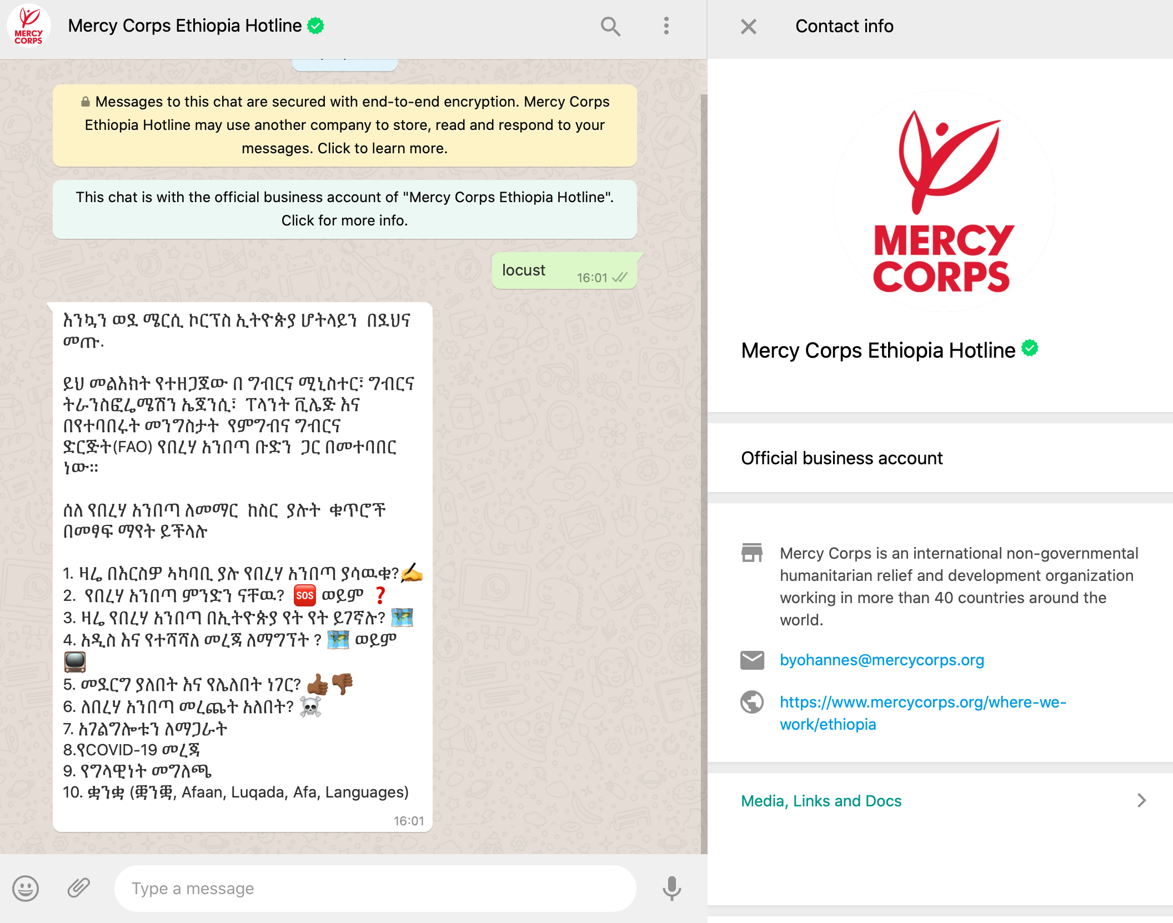
Ethiopia: Exporting Kenya best Practices and Adapting to the Context
Agricultural Transformation Agency (ATA) leveraging 11,000 district advisors by sending SMS, IVR via 8028 service and Whatsapp survey platforms.
Over 2,000 responses of sightings (yes or no) SMS and IVR per week - great sample size!
ATA is reaching 5 million farmers across all platforms including TV and Radio in 5 languages!

Slide 24

There is no “wrong” digital channel - for citizen reporting in rural communities.
Citizen Reporting is only as good as the response/feedback to the report for farmers. Do farmers feel action was taken with the information they shared digitally?
We are in the early days of using SMS, IVR, Whatsapp, Facebook groups for farmer reporting - more use cases to be deployed!
Data sharing system setup, expectation setting is critical - strong ecosystem coordination necessary to translate into practice.
In a world of climate change farming communities are on the front line - it's the crowd who will want the quick information response/can respond en masse in real time

Slide 25

Q: What have we learned about leveraging digital technology in emergency response?
Q: What have we learned about building the partnerships it takes to work across countries, languages, contexts and digital environments?
Q: We know that climate-related shocks and emergencies are going to continue to impact farmers across Africa. How can we prepare ourselves to be nimble and effective in the future?
Q: From the audience - please share in the chat!

Slide 26


Slide 27
Rapid ecosystem building relies on partners complementing each other’s strengths - starting with farmer centric in delivery goals
Data sharing system setup and expectation setting is critical
And open source and public good approach is especially important in crisis response using digital
Complex partnerships with big data require a well resourced data management organisation/s in the center of the effort is essential
In a world of climate change farming communities are on the front line - so it's the crowd who will want the response/can respond en masse in real time

